Slide 1

The best stories and greatest connections
form in exciting environments.
Be part of the next story:
Nordic+ goes Birmingham

Slide 2
ITS World Congress 2027
25 – 29
NEC
15 k
100+
530+
1
October
Birmingham, UK
Attendees
Countries
Exhibitors
Nordic+ Pavilion

Slide 3
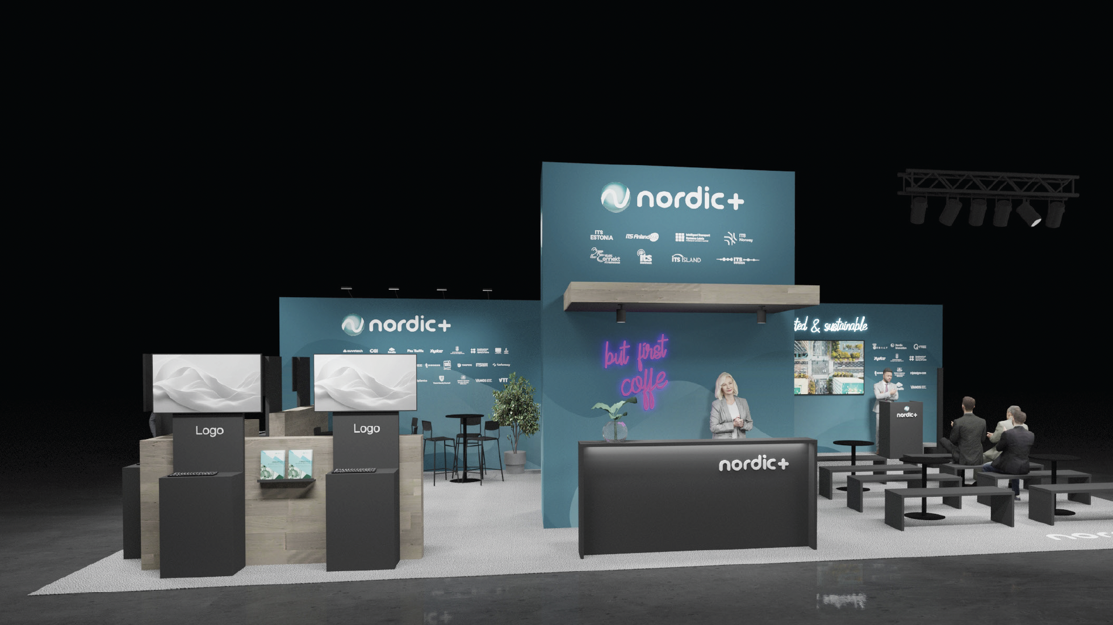

Nordic+ Pavilion
✅ 88 m² shared space
✅ Premium location

Slide 4




























Who’s going to be there?
The last Nordic+ Pavilion at Intertraffic 2026, featured 20+ public and private organizations through the Nordics and Baltics - many of whom have already reserved their place at the next Nordic+ Pavilion:

Slide 5
At Nordic+ Pavilion you will
Create connections that last
beyond the event
Meet with funders and projects to find opportunities for growth
Find new partners and new angles to
develop your business

Slide 6
Partnership packages
Product+
Classic
1. Pavilion networking
2. Pavilion content
3. Marketing & visibility
4. The legendary Nordic+ Night
+ Bring your product
✅
✅
✅
✅
✅
✅
✅
✅
✅
❌
7500 €*
5000 €
* Product+ package includes a place for either your product or one screen at the Pavilion. A combination of a screen and product will come with additional cost.
Any additional costs from especially large product sizes or other additions will be added to the package price.
VAT not included in the price.

Slide 7
+
1
2
3
4
Pavilion networking
Pavilion
content
Marketing & visibility
Nordic+ Night
& side events
Bring your product
Nordic+ Pavilion receptions
Invite clients and guests to meet at the Pavilion
Logo visibility
Export market advice
Lunch and refreshments
+ more
Pitching and presentations at the Pavilion scene
Demo and launch products and services
Events and delegations with other countries based on participants’ interests
Nordic+ brokerage event for EU Horizon calls
+ more
Nordic+ webinars and pitching coaching
Social media marketing in Nordic+ channels
Nordic+ Web page to publish your contents
Nordic+ Newsletter coverage
+ more
Nordic+ Night tickets
Events and dinners hosted by your local ITS organisation
Invite guests to invite-only side events
+ Ask your local contact for more information
Product display or one screen dedicated for your use only at the Pavilion
Product presentation at the Pavilion scene
+ Ask your local contact for more information

Slide 8
Nordic+ Pavilion connects
Networking
Matching
Visibility
Showcase latest innovations from the Nordics and Baltics together with 25+ Partners
Joint efforts for matching with local stakeholders and Nordic+ side-events
Logo visibility
Visibility through social media
Joint press releases

Slide 9

Book your place now
Sanni Remonen
Finnish Mobility Export
+358 40 727 0203
sanni.remonen@its-finland.fi
Mikonkatu 9
Epicenter
00100 Helsinki
Nordic+
Connected & Sustainable
www.its-finland.fi

Slide 10
